Slide 1
Mobile Apps For Veterans’ Families and Couples
Beth Jaworski, PhD, Jason Owen, PhD, MPH, Jessica Cuellar, PhD, Erica Simon, PhD, Kile Ortigo, PhD, Shannon McCaslin, PhD, Andrew Chang, MA
National Center for PTSD
VA Palo Alto Health Care System

Slide 2
Presentation overview
Background (~10 minutes)
Research Background & Rationale for PTSD Family Coach 2.0
Couples Coach (Paper Pilot + App Development)
Key Areas for Stakeholder Input

Slide 3
Introduction to presenters
Jason Owen, PhD, MPH
Beth Jaworski, PhD

Slide 4
Introduction to presenters
Ad

Slide 5

Treatment Companion Apps

Slide 6

Self-Management Apps

Slide 7
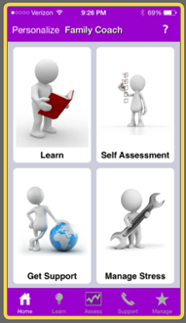
PTSD Family Coach
PTSD has a significant impact on family members’ responsibilities and emotional functioning
Family members are also critical to Veterans’ recovery, reintegration into family and social life, and willingness to seek PTSD-related care
Family and couples resources for Veterans with PTSD are limited, and unmet needs for these services are high
PTSD Family Coach was designed to meet these unmet needs
The app was modeled on PTSD Coach & designed to provide basic stress-management skills, stress tracking, education, and access to critical resources

Slide 8
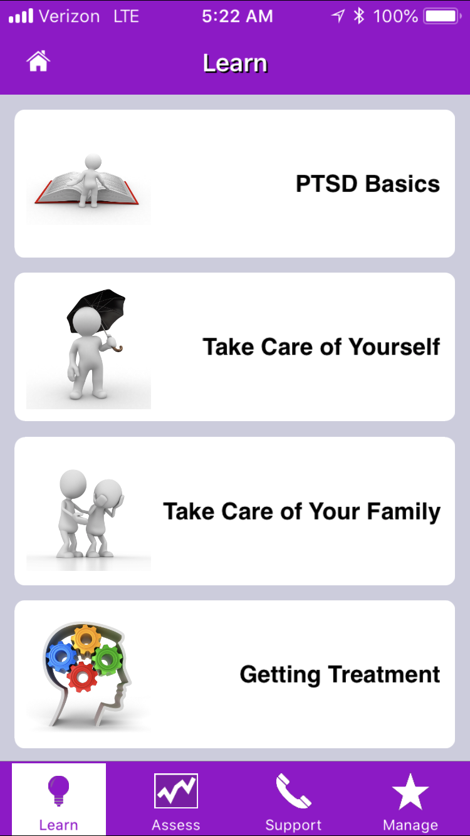
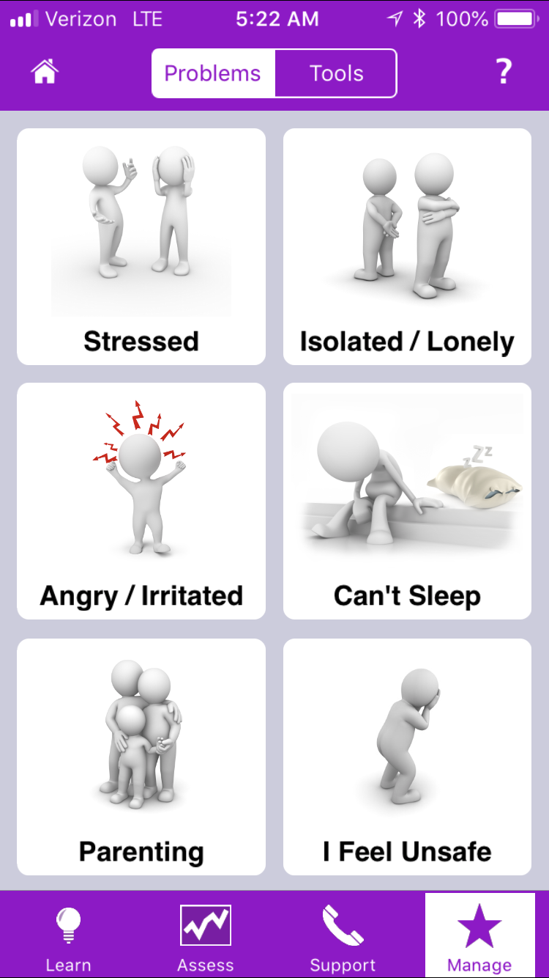
Learn
Tools

Slide 9
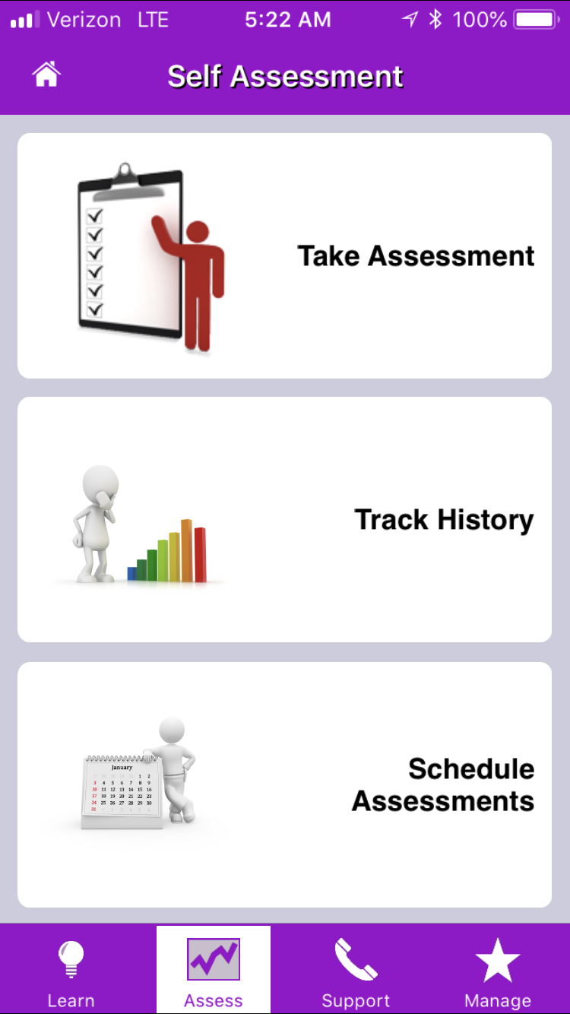
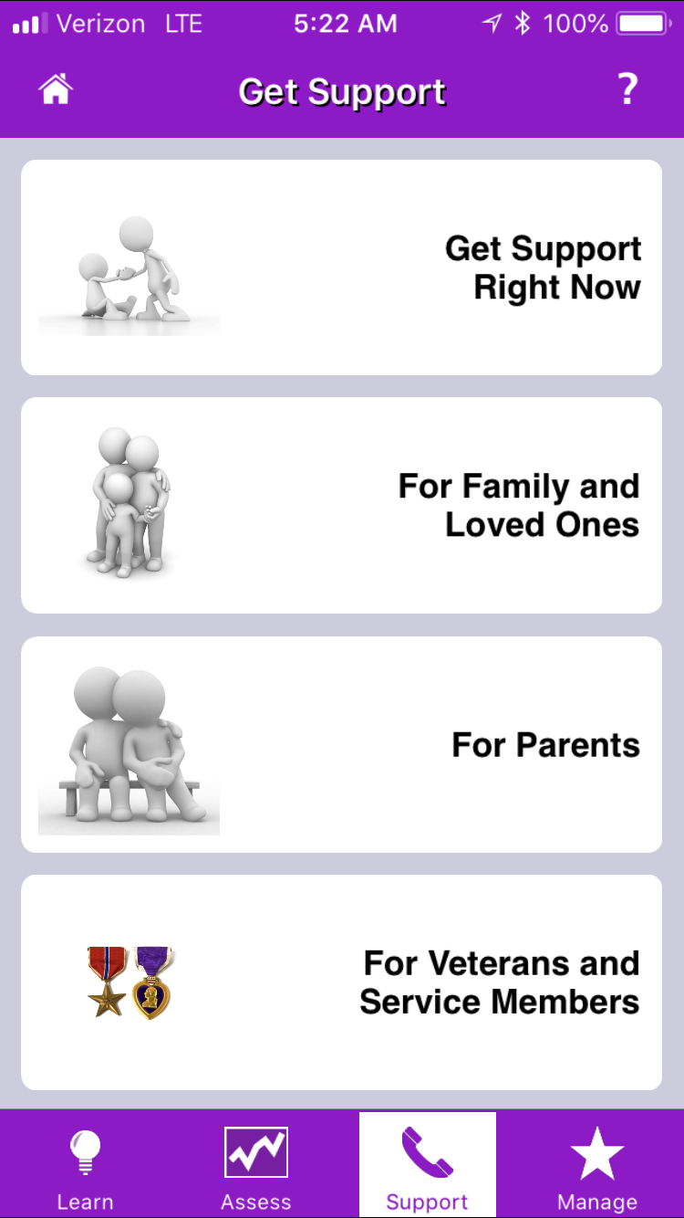
Track Progress
Get Support

Slide 10
Current Studies with Family Coach
1. Understanding experiences of family members seeking an app to help manage Veterans’ PTSD (study 1, n = 212)
2. Outcomes & engagement associated with a screening trial of Family Coach (study 2, n = 100; being analyzed)
3. Couples Coach (n = 60 couples, in analysis)
Notes:
This was our first

Slide 11
Participants
Living with a Veteran
Veteran is a close family member
Veteran previously diagnosed with PTSD
Have an iOS device
Interested in a mobile app for family members of Veterans with PSTD
>18

Slide 12
Procedures
Recruited via social media, targeting Veteran-centric interests
Qualtrics survey for screening, assessment
Self-report assessments at baseline & 1-month follow-up
Ad-hoc app distribution
Those who downloaded the app received 1 of 2 app variants

Slide 13
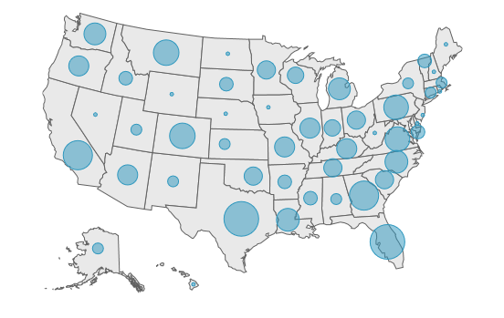
Participants

Slide 14
Key Findings (J Fam Studies, 2017)
Nearly 60% report moderate to severe burden
Nearly 60% report moderate to severe depression
Nearly half report seriously thinking about leaving their Veteran
Top qualitatively-identified concerns: - wanting help managing PTSD sxs
- support for interacting with healthcare system
- relationship concerns
- caregiver burden
- safety-related concerns
Notes:
Managing PTSD Symptoms INCLUDES: dealing with flashbacks, need for information, alcohol use/TBI-related concerns, functional consequences of PTSD
Relationship Issues: feeling alone in the relationship, communicating with veteran, strained family relationships, parenting/children concerns
Healthcare Support: getting the veteran into/engaged in treatment, need for counseling for the family member
Caregiver Burden: chronic hardship and caregiver strain, social isolation
Caregiver Safety: interpersonal abuse, fear of violence
ADD FREQUENCIES OF EACH CATEGORY

Slide 15
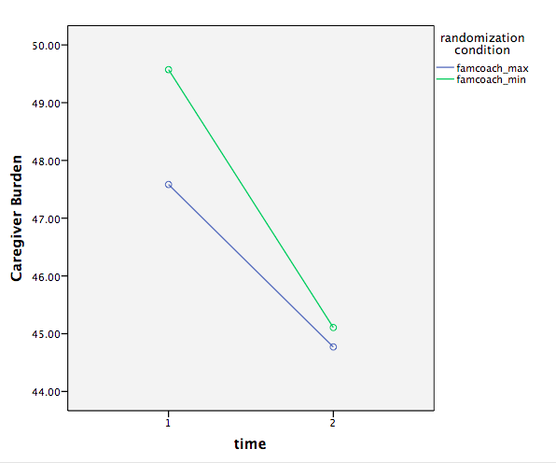
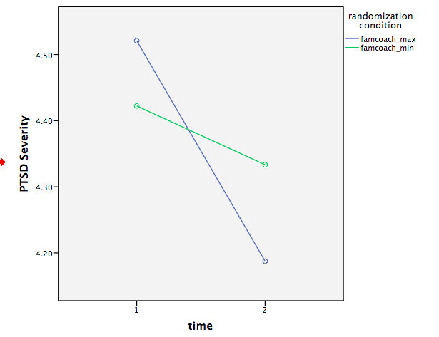
Family Coach: Changes in Burden and Perceived PTSD Severity

Slide 16
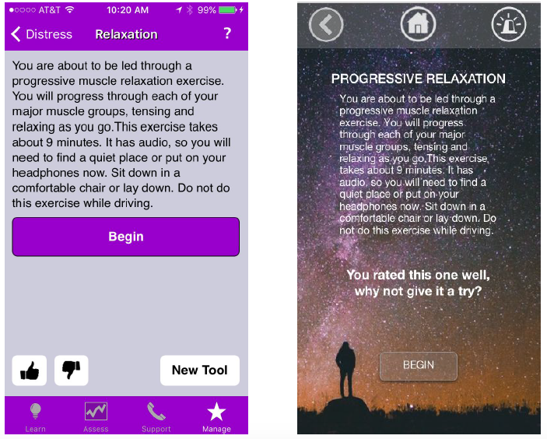
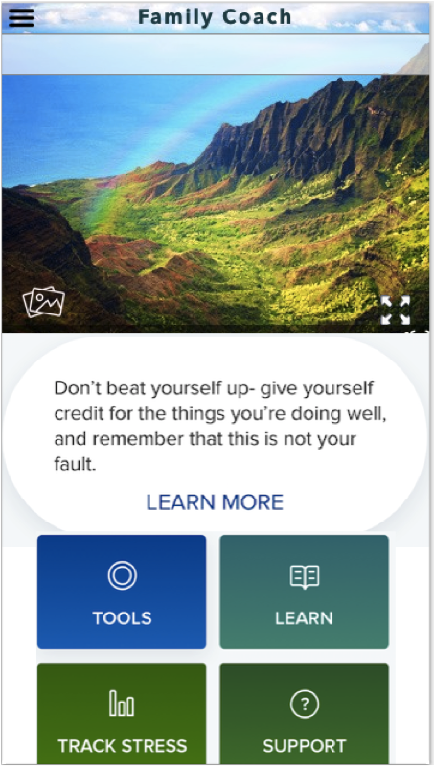
Family Coach Re-Design
Notes:
Earlier this year, Beth Jaworski partnered with couple of UX students in San Francisco to imagine an update and re-design to the Family Coach user experience. So while we’re currently lacking the funds to fully implement that re-design, we are hoping that we will be able to find ways to fund this in the near future. They’ve re-imagined the app in the following ways:

Slide 17
Question Break
Before we talk about Family Coach 2.0, any questions about anything we’ve discussed so far?

Slide 18
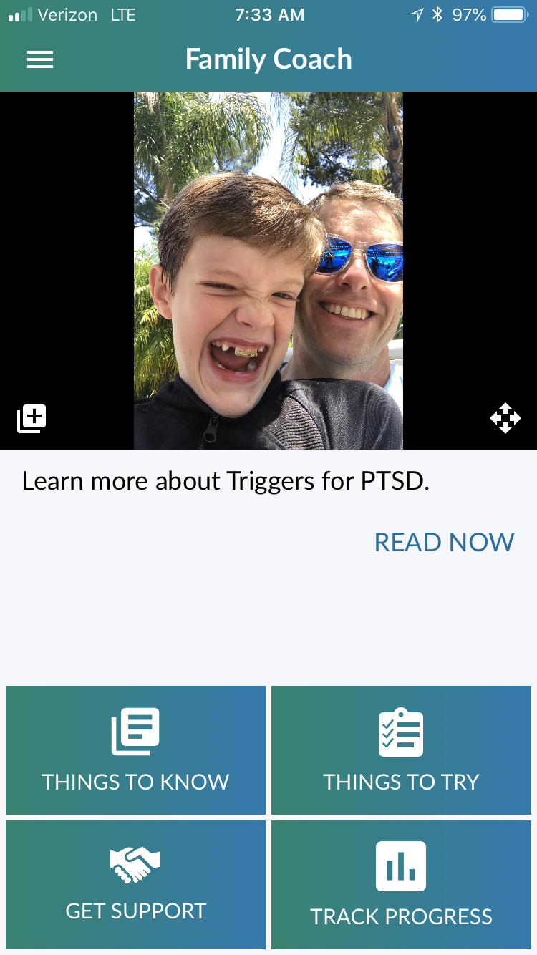
FAMILY COACH 2.0 (iOS & Android)
Major updates- anticipated release July 2018:
UX re-design
Customization to user’s specific needs & use of the app
Coaching & inspiration
Completely revised topic library
Addition of dozens of new tools designed to address perceived shortcomings of FC 1.0
Updated tracking & progress monitoring
New & updated support resources
Type to enter a caption.

Slide 19
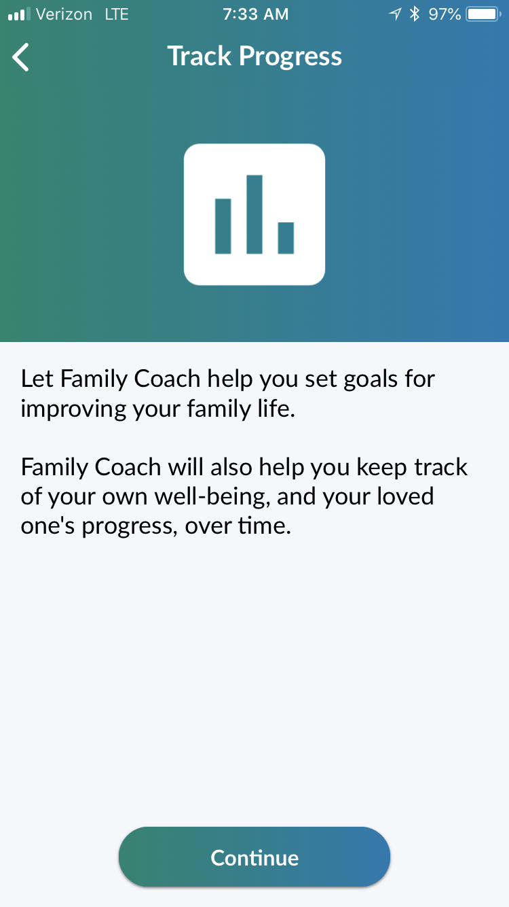
Track Progress
PCL-5 Partner Version for tracking PTSD symptom changes
Warwick-Edmonton Emotional Well-Being Scale for tracking users’ functioning over time
Personal and family goal tracking
Streaks & reminders
Type to enter a caption.

Slide 20
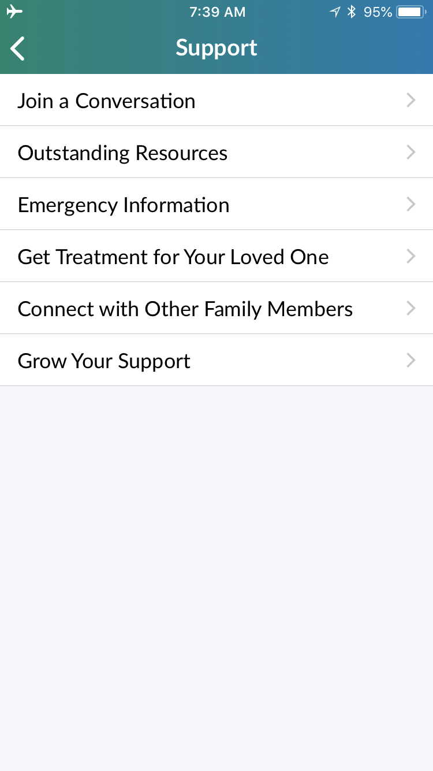
Support
On Twitter?
#PTSDFamilyCoach
Re-tweet & share as widely as you can
Encouraging stories of families dealing with PTSD
Promoting the app
Type to enter a caption.

Slide 21
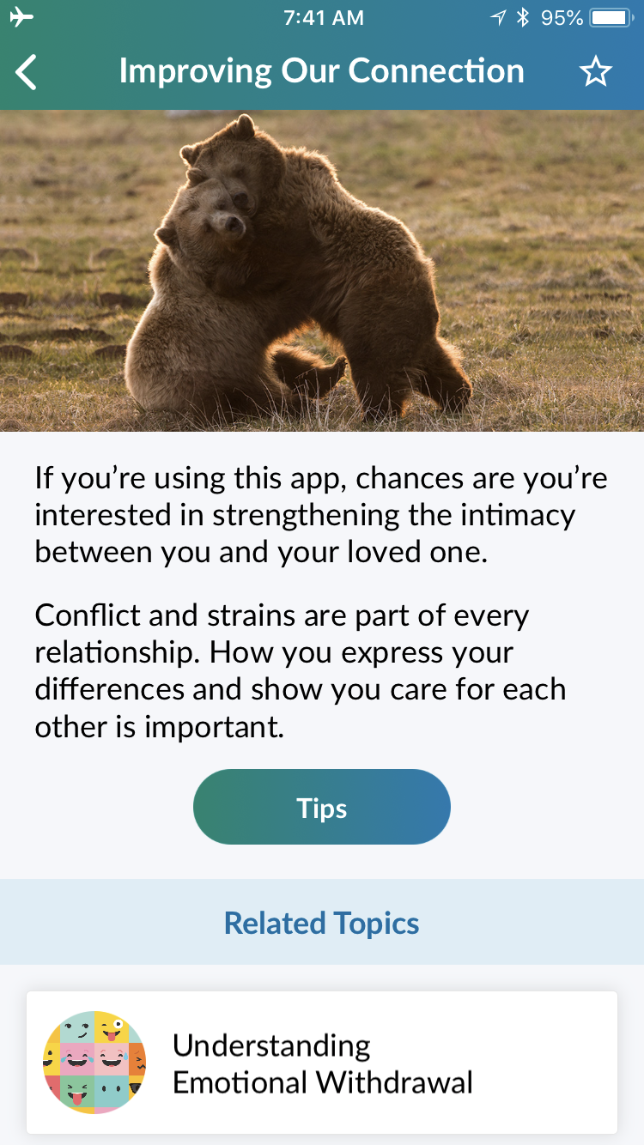
Learn topics/psychoed
Family Coach 1.0 has 57 topics across 4 categories
Family Coach 2.0 has 168 topics across 12 categories
Redesign to make psycho-ed more appealing:
visually
practically (concrete tips)
usability (recommended & related topics)
Type to enter a caption.

Slide 22


Tools

Slide 23
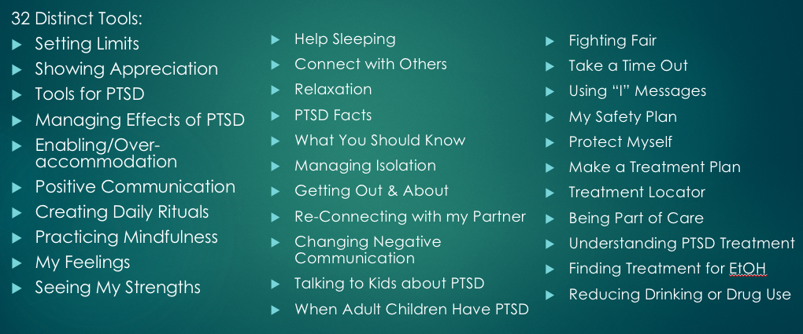
Tools

Slide 24
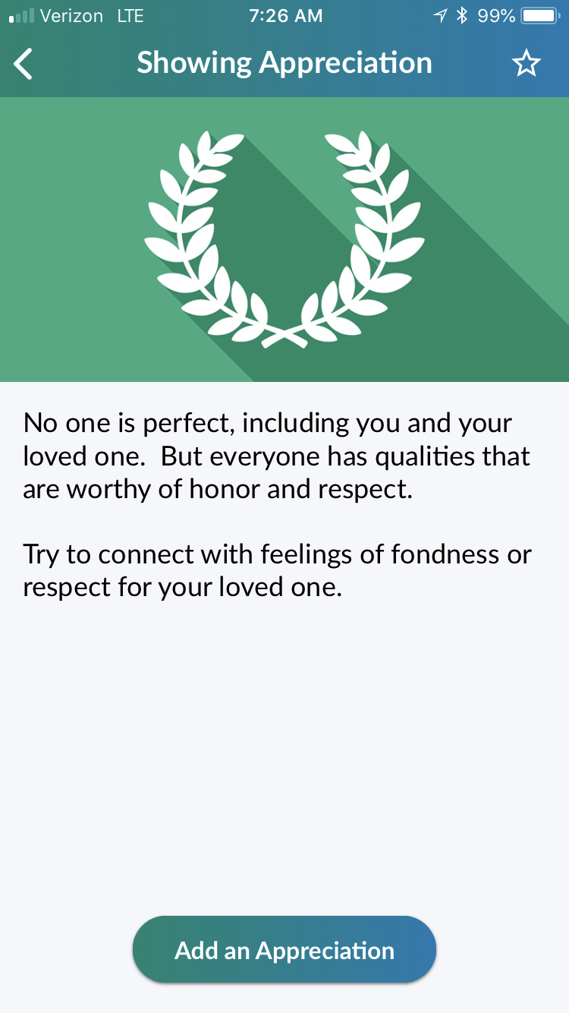
Tools
Type to enter a caption.

Slide 25
Question break
Questions or thoughts about the app?

Slide 26
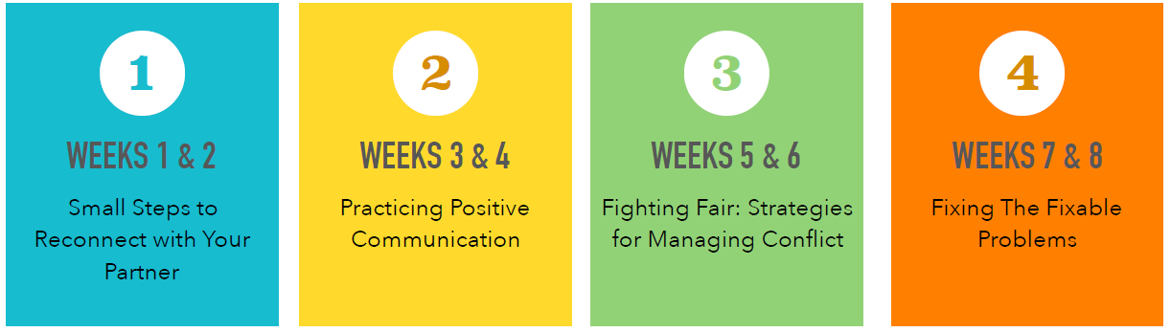
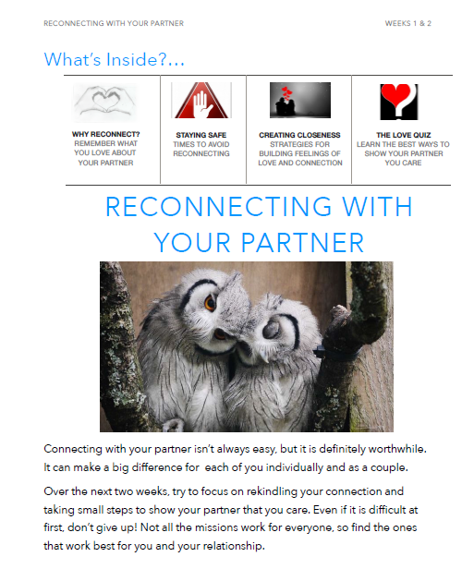

Couples Coach

Slide 27
Contact Us
Bugs/Suggestions/Questions: MobileMentalHealth@va.gov
Beth.Jaworski@va.gov
Jason.Owen@va.gov

